Slide 1
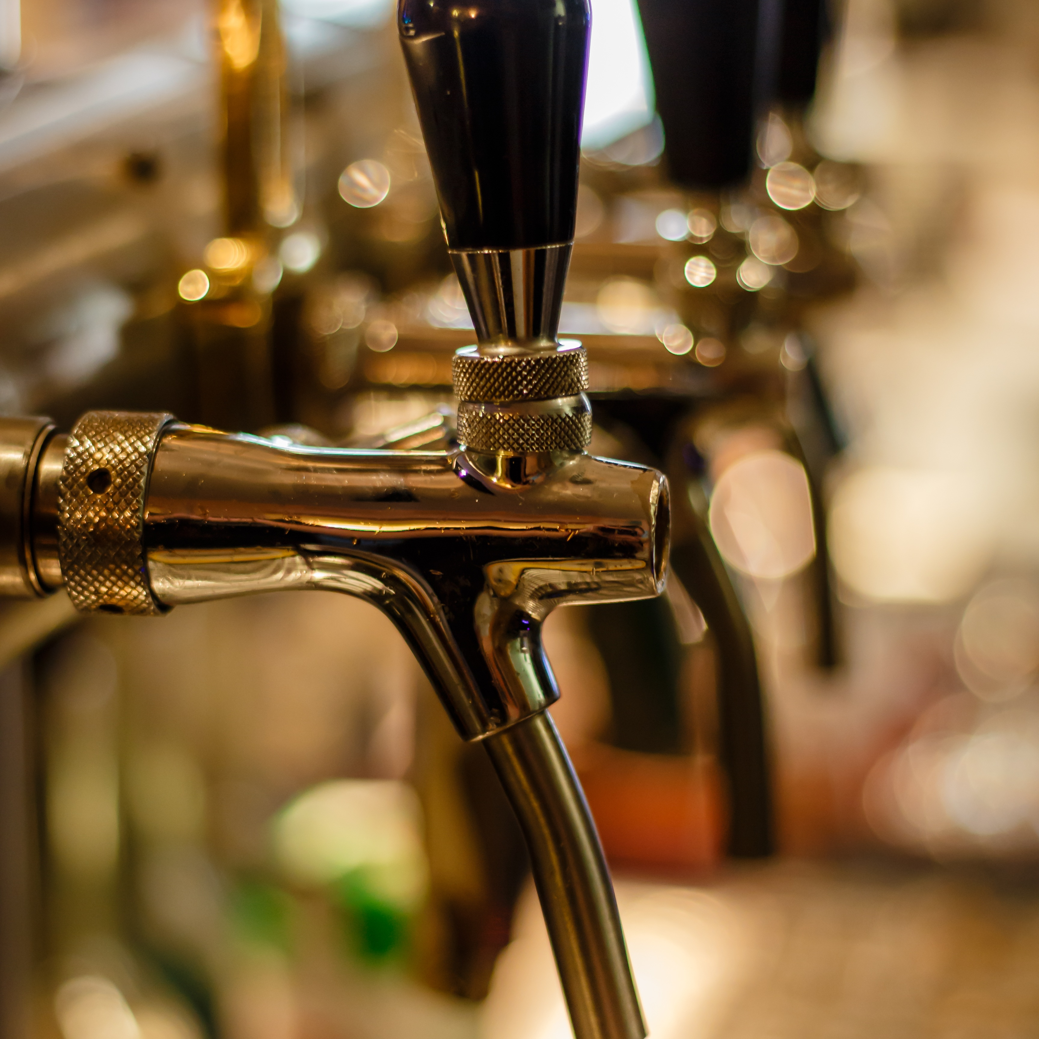
Beers & Breweries EDA
Kendall Scott
Miguel Bonilla
Notes:
Good evening. We are here to share the results of our exploratory data analysis on Beers and Breweries across the United States.

Slide 2
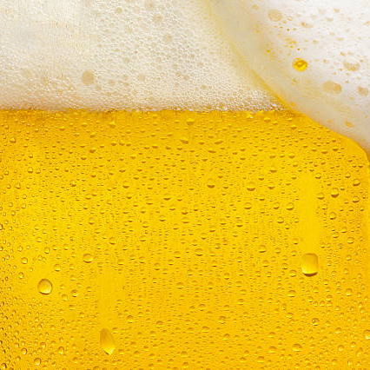
The analysis
Dataset
Looking at data from 558 breweries
Over 2,400 beers
Analysis of
Alcohol by Volume(ABV) for 2,348 different beers
International Bitterness Units (IBU) for 1,405 different beers
Notes:
Here’s a breakdown of the information that was used for this analysis.
The data we were provided included information for 558 breweries and over 2400 beers from all 50 US states and the Washington DC area. Our analysis was focused on the Alcohol by volume (or ABV) for 2,348 beers and the International Bitterness Units for 1405 beers.

Slide 3
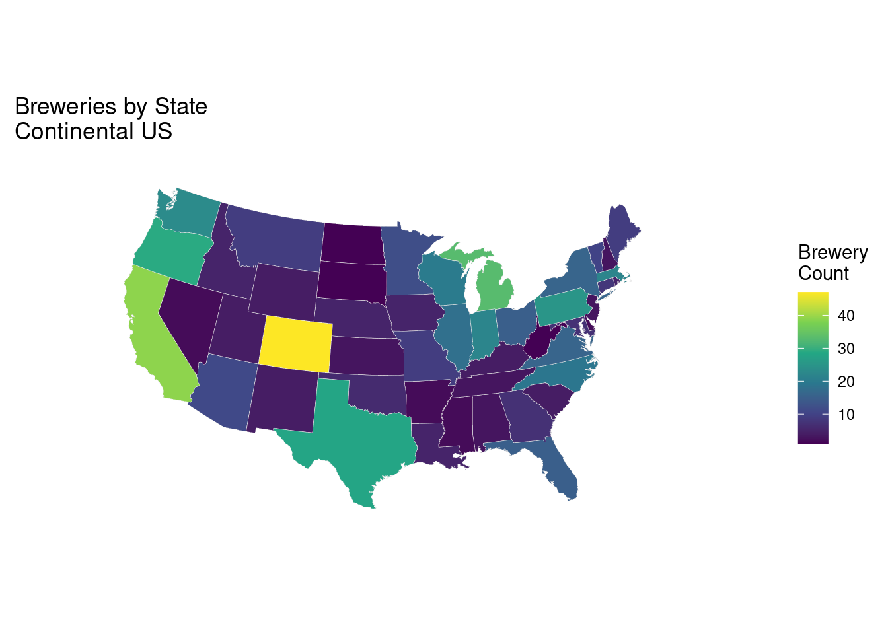
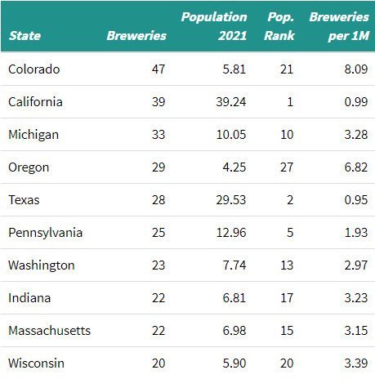
Breweries by State
Notes:
As requested, We broke down the number of breweries to see how many were located in each state, we can see that the west coast has a large number of breweries, with all 3 states in the top 10 with most breweries. Colorado is number one on the list with 47 breweries, even though the state ranks 21st in overall population with 5.81 million residents (by 2021 estimates), California is second in number of breweries, even though it ranks first in population with a population almost 7 times the size of Colorado. Oregon ranks 4th in breweries with 29, and it’s the smallest state by population in the top 10 breweries by state.

Slide 4
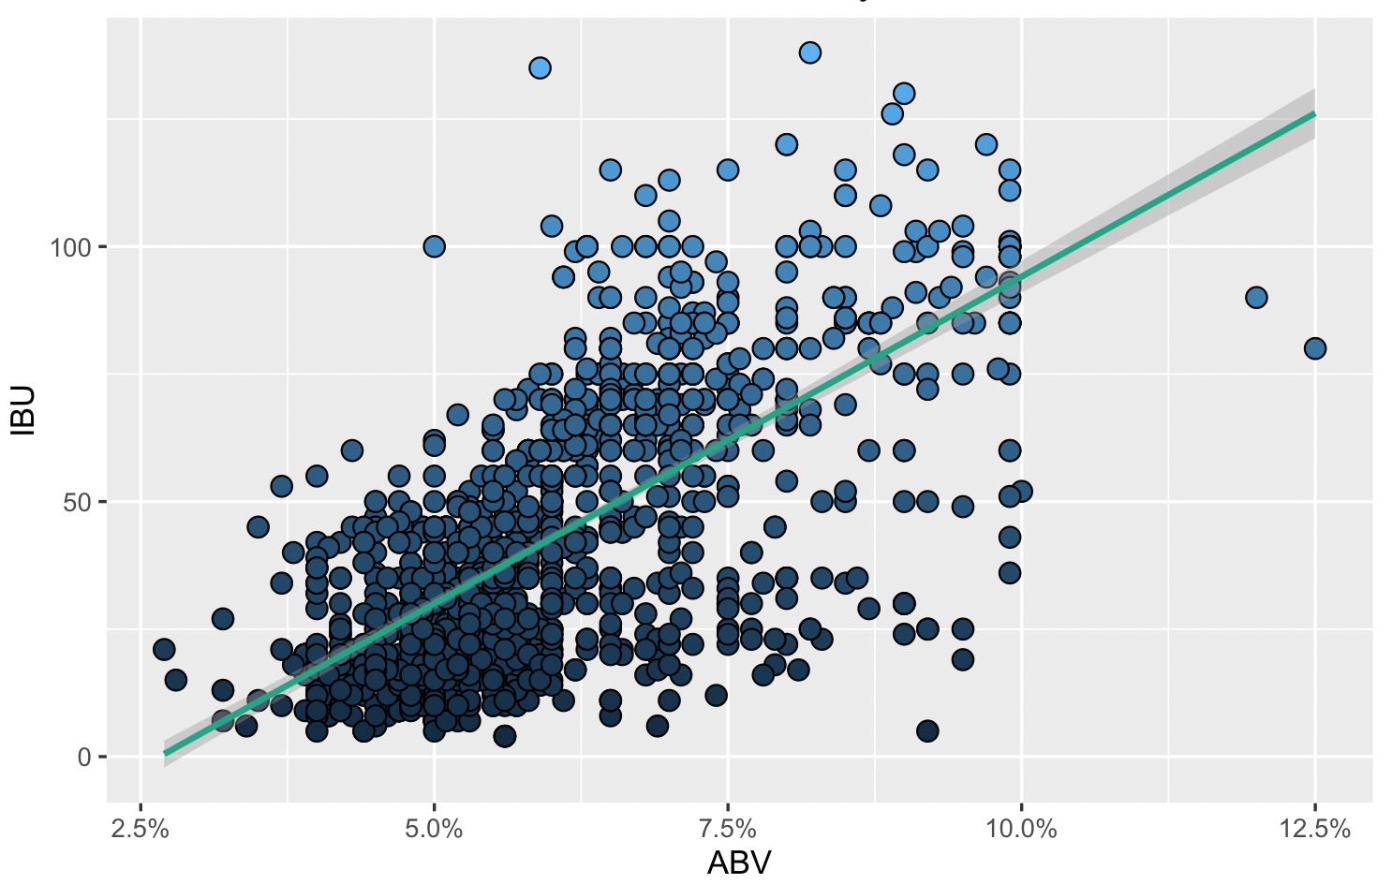

International Bitterness Units (IBU) vs. Alcohol by Volume (ABV)
There is evidence of a positive relationship between ABV and IBU.
IBU
4

Slide 5

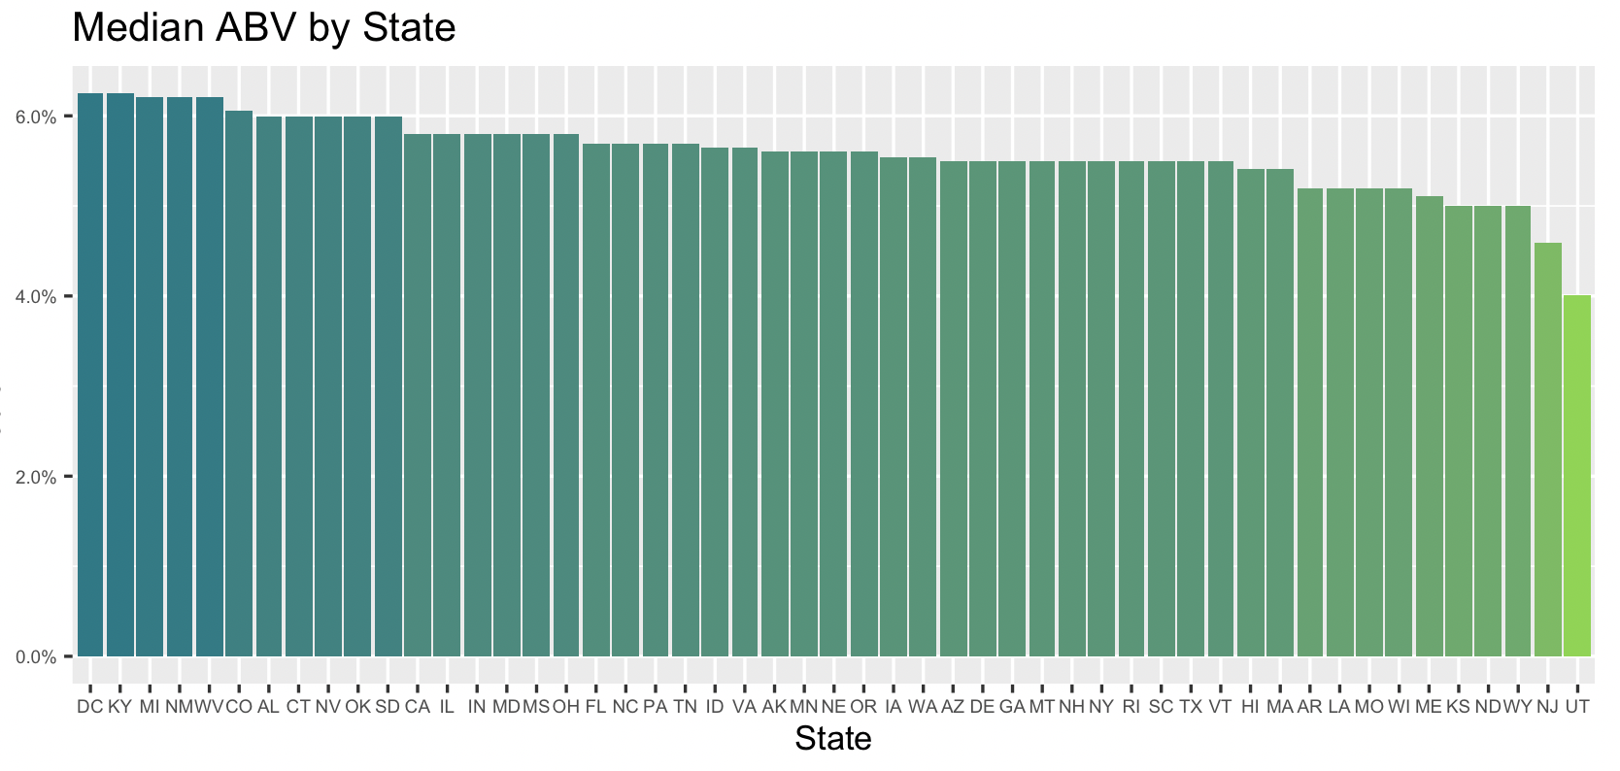
Alcohol by Volume
Median ABV
DC and Kentucky have the highest Median ABV. Both states have a high % of brands with the American Double / Imperial IPA, which has an ABV between 7-14%

Slide 6
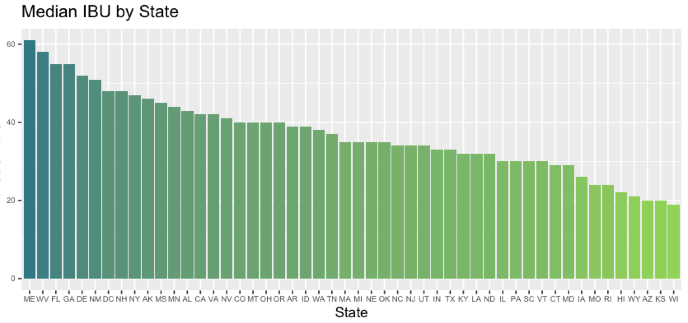
Bitterness by State
Median IBU
xx
Maine and West Virginia have the highest Median IBU. Maine is known for the IPAs, which indexes higher on IBU.

Slide 7
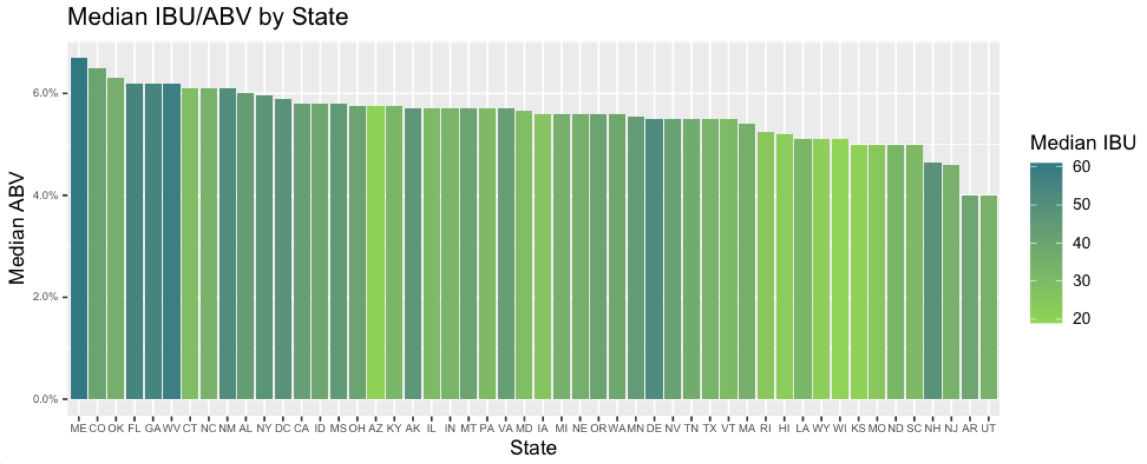
ABV and IBU by State
Delaware and New Hampshire have some of the highest IBU for their ABV. There are some articles from Delaware about "table beer" and low ABV fruit beers.
However, both states combined represent <1% of the data of the overall data.

Slide 8
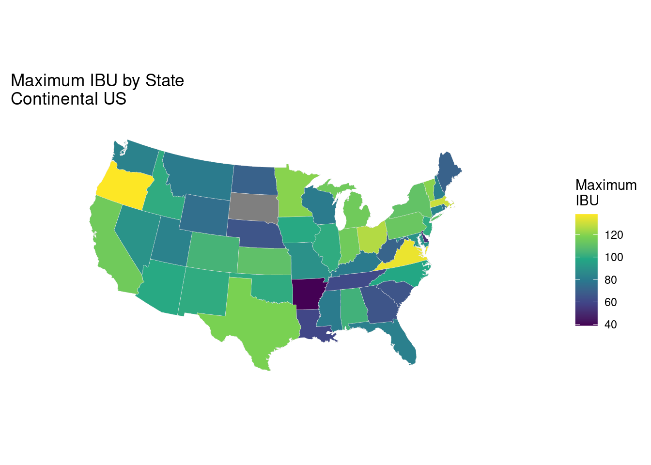
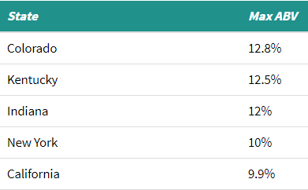
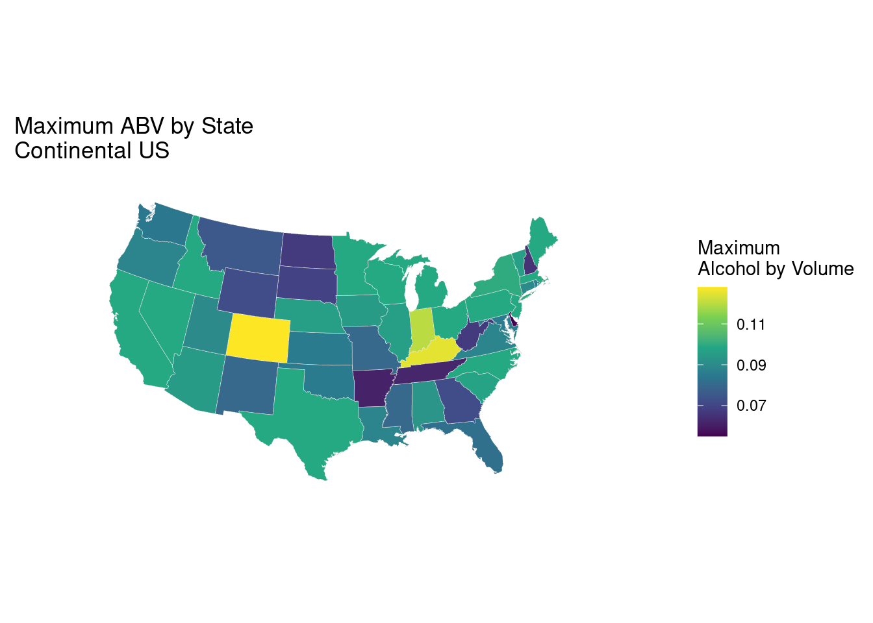
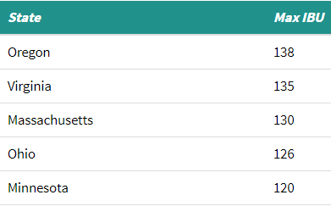
Maximum ABV And IBU By State
CO max ABV allowed in grocery stores 3.2%
SD brewery did not report IBU
Notes:
Here we can see the breakdown of ABV and IBU by state. The state with the highest ABV is Colorado, which was also the state with the largest number of breweries. Colorado has a maximum ABV of 12.8%, even though the maximum ABV allowed to be sold at grocery stores across the state is only 3.2%, Colorado is followed closely by Kentucky and 12.5 and 12%.
Not all breweries report IBU values for their beers, and this sample significantly smaller as mentioned earlier, the sample included only one South Dakota brewery, which did not report IBUs, this is reflected on the map where the state is blank. The state with the highest IBU was Oregon, but interestingly the maximum IBU values were closer among the states than ABV which could reflect a reporting bias where only the values for more bitter brews gets reported.

Slide 9
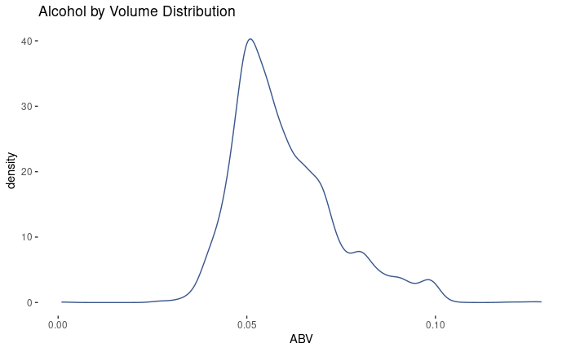
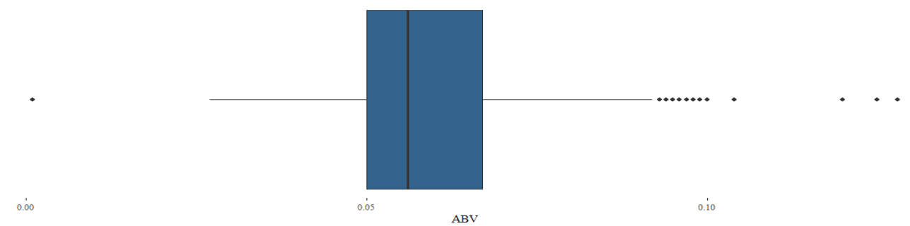
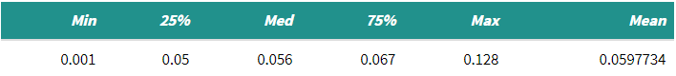
ABV Distribution
Right Skewed Distribution
Pronounced peak at .1 ABV suggests rounding
Only one beer below .1% – Scotty K Na (discontinued low alcohol beer)
Notes:
Here we can see the alcohol by volume distribution for all 2348 beers in the sample. We can see that the distribution skews right, one thing of note is that the distribution has a pronounced peak just under 10% ABV, This could be an indication of rounding, since there is a much larger number of beers with an ABV of 9.9% than with values slightly above or slightly below that mark. It seems breweries are targeting the spot right under 10%. Another thing of note is that there is an outlier on the low end of the distribution, The smallest ABV value corresponds to Scotty K Na, a discontinued low alcohol content brew with an ABV of .1%

Slide 10
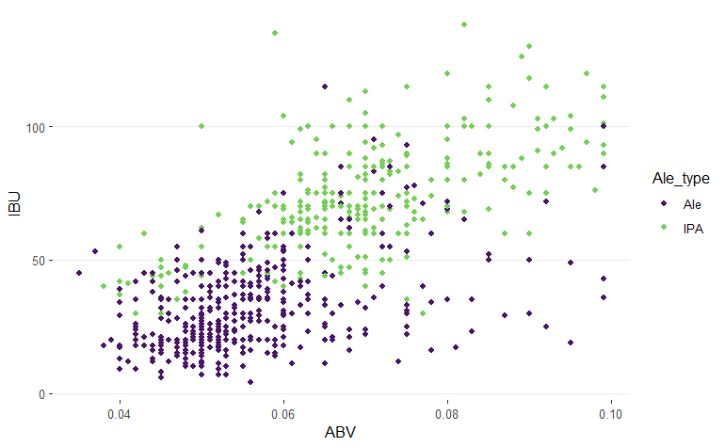
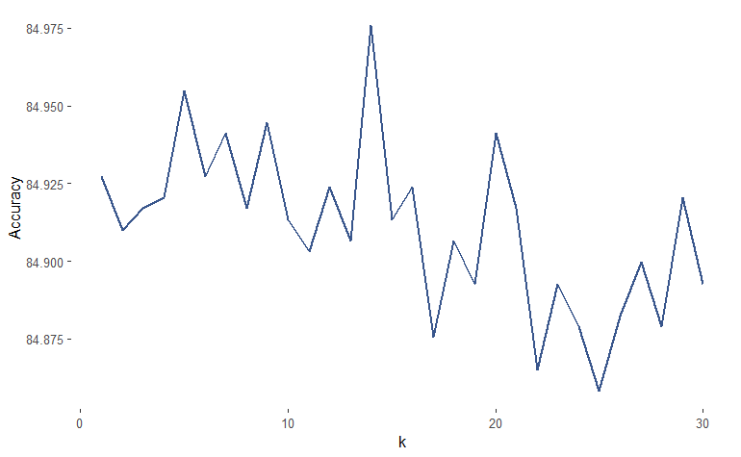
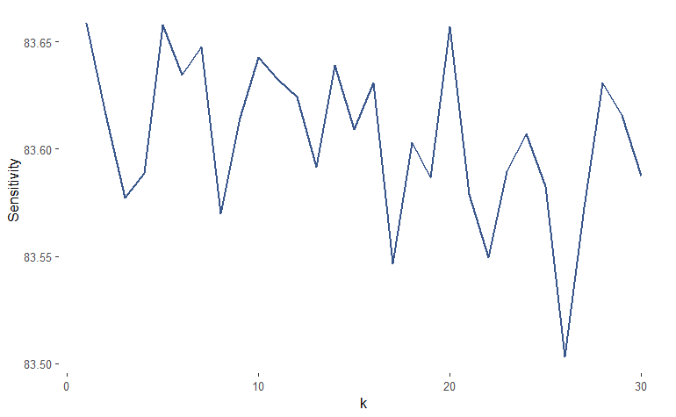
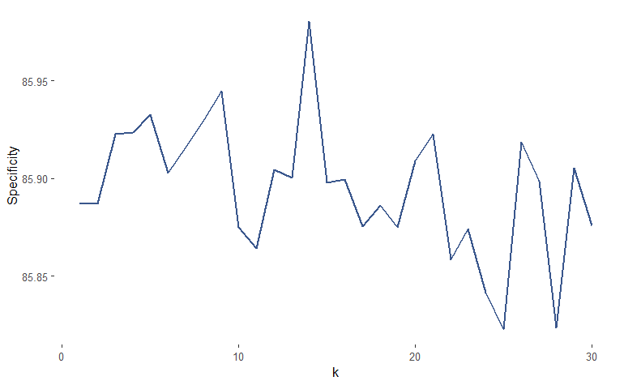
KNN IPA/Ale Classifier
K=14
Classify as either IPA or other Ale based on ABV and IBU levels
Looking at the 14 closest beers (k=14) produces best results
Model accuracy 84.98%
Specificity 85.98%
Sensitivity
K=3
Notes:
The KNN model classifier allows us to predict the Ale type (IPA or other) of a beer based on its closest beers in terms of ABV and IBU levels. For our data, the model performed best at predicting ale type when looking at the 14 closest beers, with an accuracy of almost 85%. In other words, we believe the model will properly categorize a beer’s ale type as IPA or other for close to 85 out of every 100 beers.
Moreover, our model’s specificity, or its ability to properly classify other Ales as Ale was also the highest at k=14 with a value of almost 86%.
While looking at the 14 closest beers, the model properly classified IPA’s as IPA’s 83.64% of the time (slightly below the maximum sensitivity of 83.65% for k=5).
Considering the model clearly performs best in terms of accuracy and it’s ability to properly classify other ale’s as “Ale” by looking at the 14 closest beers, we believe this is the optimal model to use to classify IPA and Ales for this sample.

Slide 11
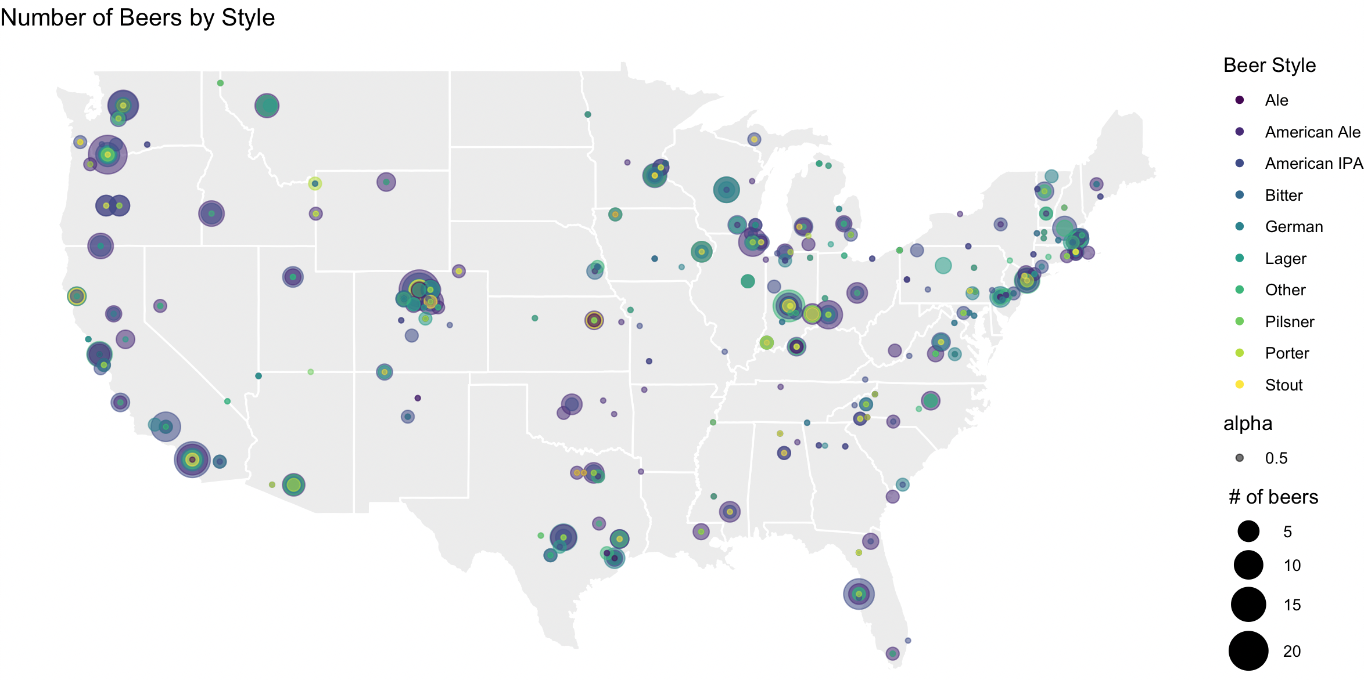
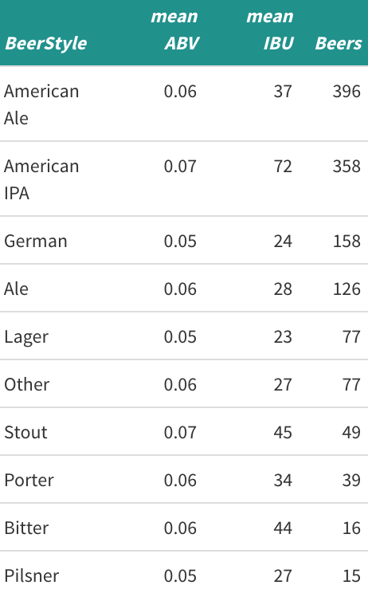
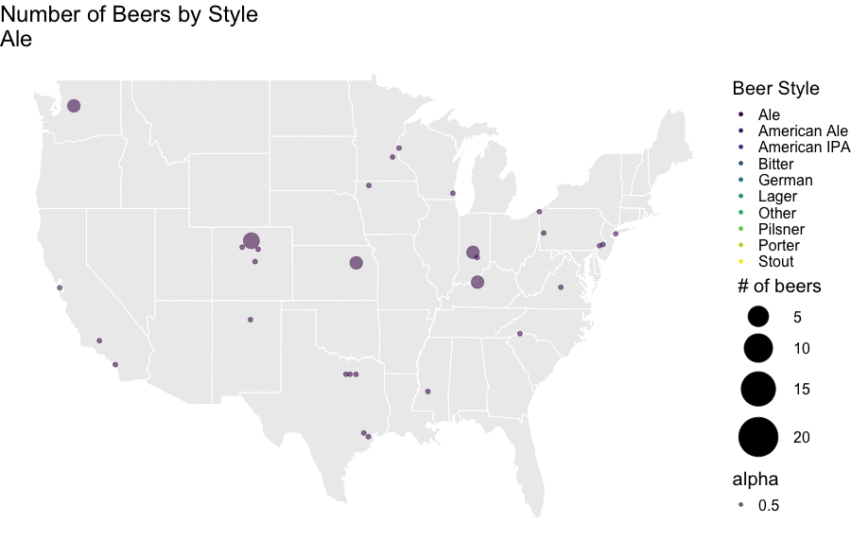
Beer Styles
American Ale and American IPA make up 57% of the beers analyzed.

Slide 12
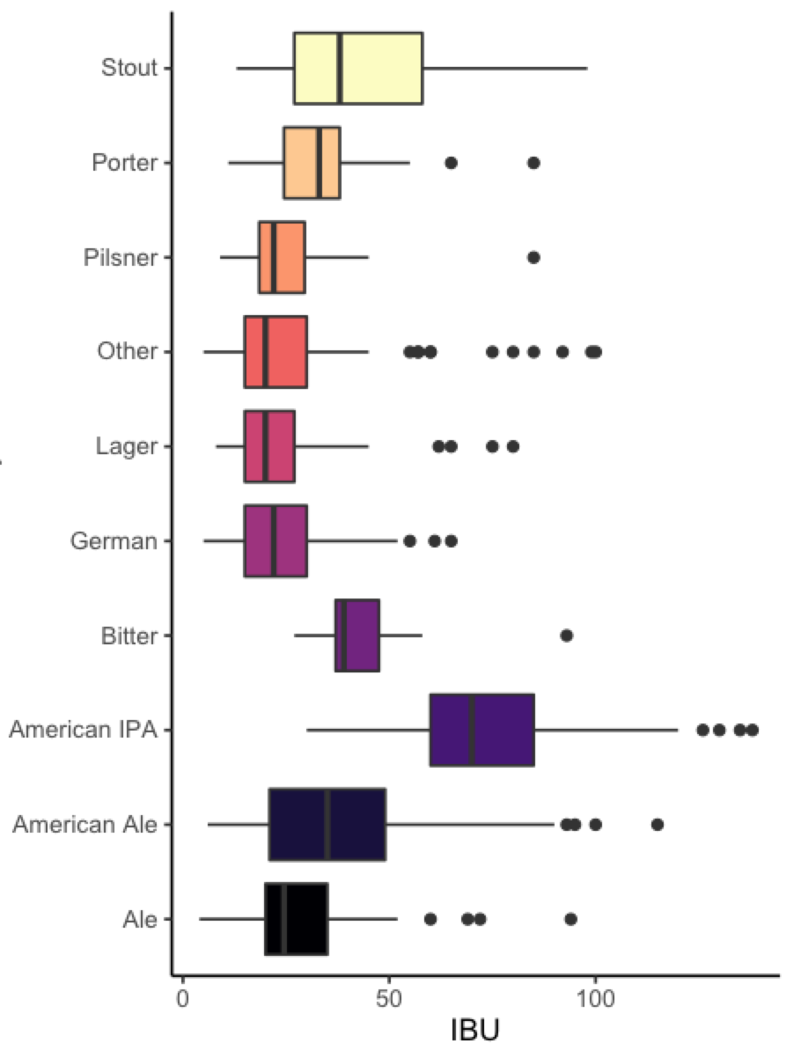
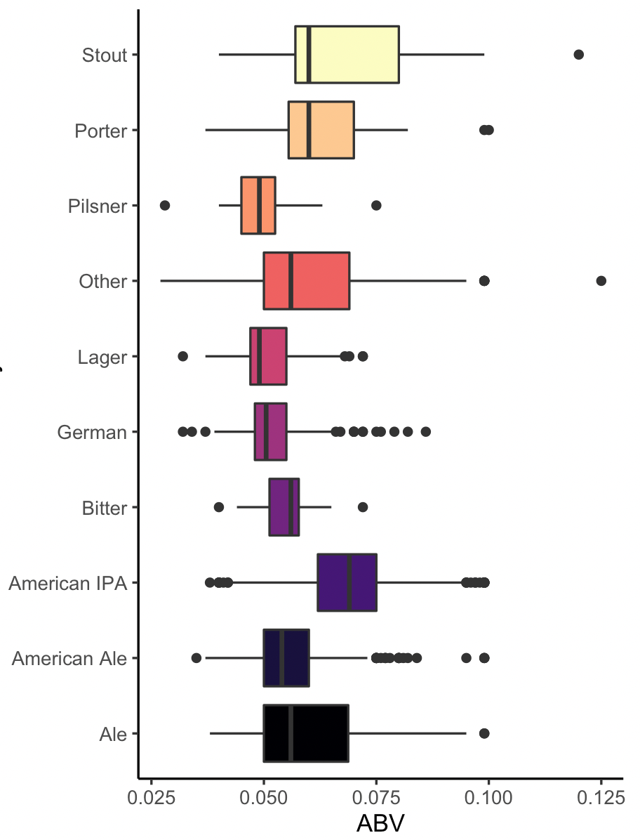
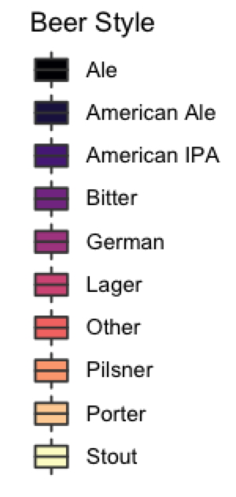
IBU & ABV by Beer Style
American IPA has the highest median IBU and ABV.

Slide 13
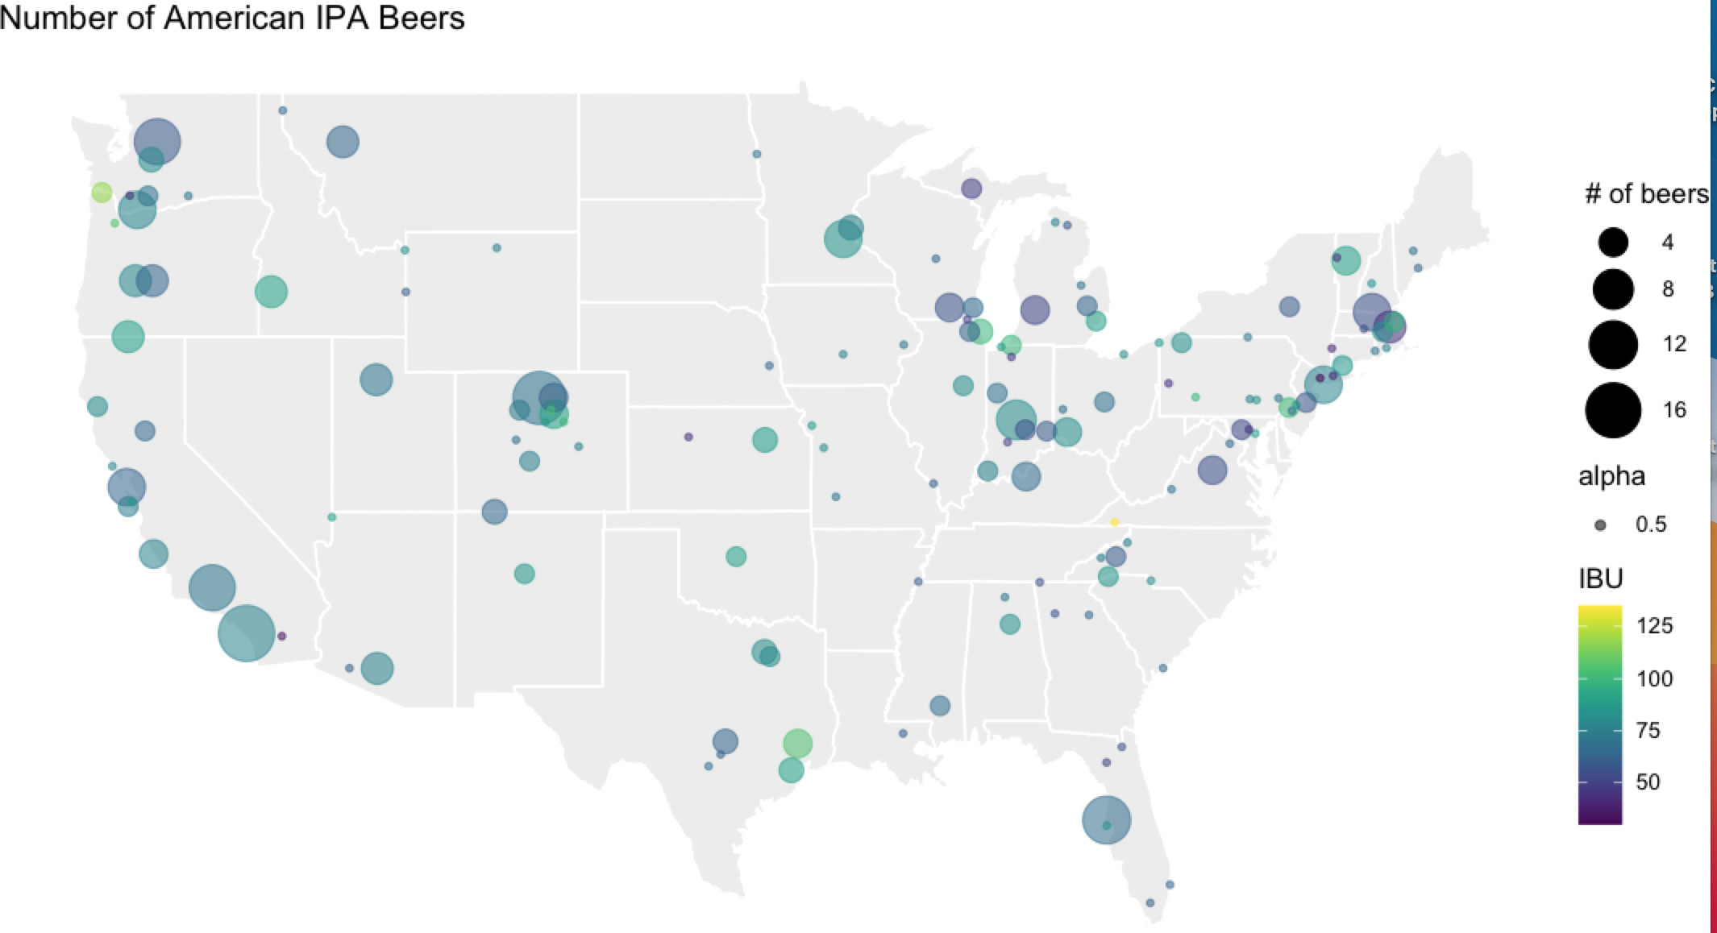
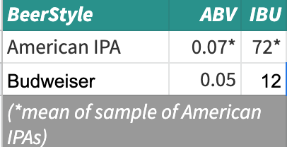
American IPA Opportunity?
American IPA was 27% of the beers analyzed.
American IPA has higher IBU and ABV than Budweiser.
There may be an opportunity for Budweiser to develop an American IPA, which has manufacturing in a diverse # of geographic locations across the US.

